Slide 1


Password Strength
By Jaden Tate, Nicholas Suda, Ryan Stika, and Dane Shuler

Slide 2
Team Members
01
02
03
04
Jaden Tate
Nicholas Suda
Meticulous Data Analysis
Unraveling Patterns
Cornerstone of Analyses
Visionary Conceptualization
Password Strength Checker
Backbone of Exploration
Ryan Stika
Dane Shuler
Analytical Powerhouse
Methodological Craftsmanship
Revealing Inner Workings
Synthesizing Collective Findings
Crafting Cohesive Narrative
Navigating Setbacks

Slide 3
Teamwork Journey
Brainstorming Sessions
Late-Night Discussions
Unwavering Support
Team Cohesion
Individual Contributions
Gratitude to Team Members

Slide 4

Enhancing Password Security
A Multifaceted Analysis

Slide 5
Introduction
Era of Digitalization
Importance of Password Security
Research Question: "What factors contribute most significantly to the strength of a password?"

Slide 6
Datasets
13 million passwords
October 2015 Data Breach
Purpose: Comprehensive View of Password Security

Slide 7

Password Strength Checker
String Analysis
Measurement of Unique Characters
Length Measurement
Character Types and Patterns
Scoring System

Slide 8
Comparison of Passwords
Longer, Less Complex Passwords
Shorter, More Complex Passwords
Time-to-Crack Assessment
Holistic Approach
Shift in Password Creation
Advocacy for Randomly Generated Passwords and Passphrases

Slide 9
Methods
Password Strength Checker:
String Analysis: Breaks down password into characters for analysis.
Unique Characters: Counts unique characters for increased resilience.
Length Measurement: Considers longer passwords for larger search space.
Character Types & Patterns: Evaluates diversity and patterns.
Scoring System: Quantifies overall password strength for users' comprehension.
Comparison of Passwords:
Longer, Less Complex: Explores longer but simpler passwords' security.
Shorter, More Complex: Assesses shorter yet more complex passwords.
Time-to-Crack Assessment: Determines estimated crack time for both types.
Graphical Representation:
Visualizes relationships between length, complexity, and security."

Slide 10
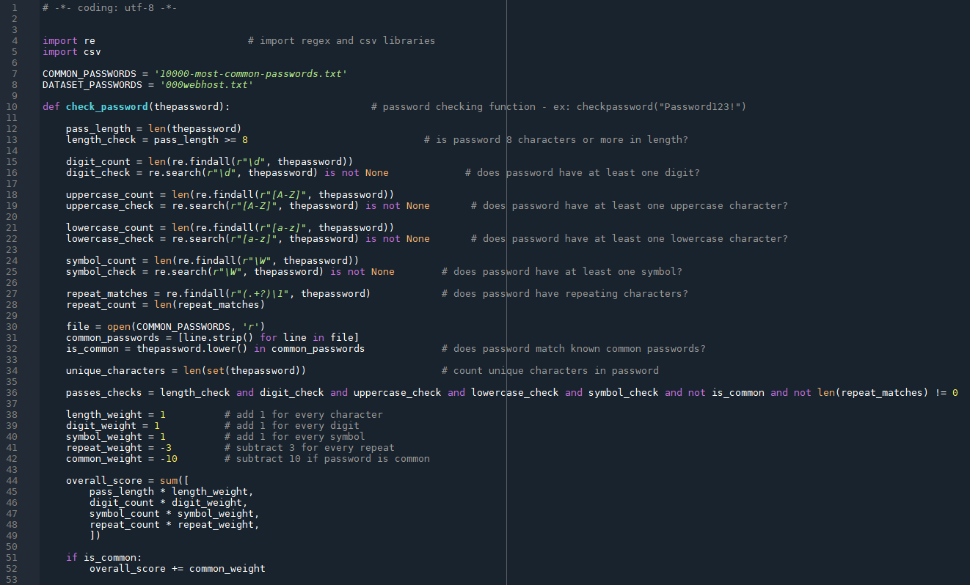
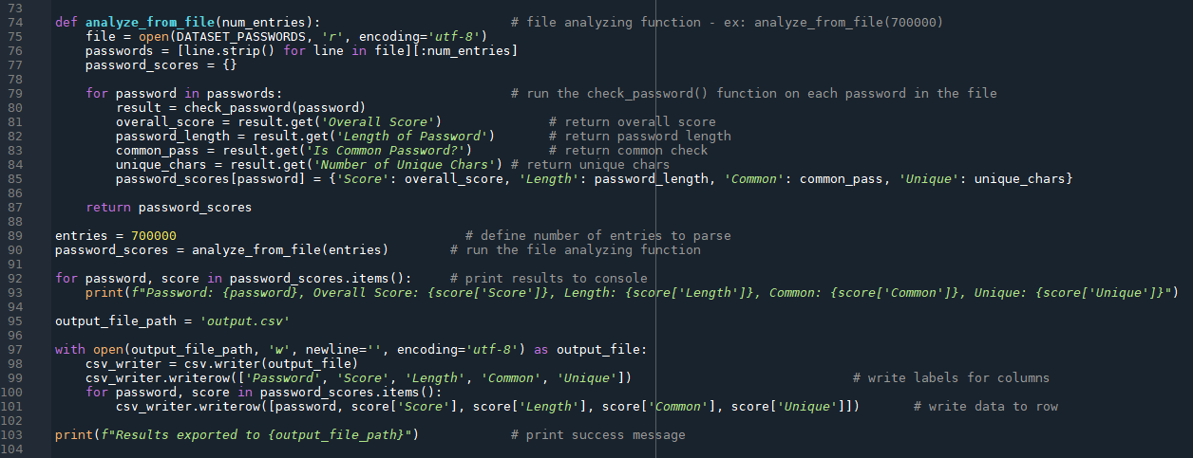
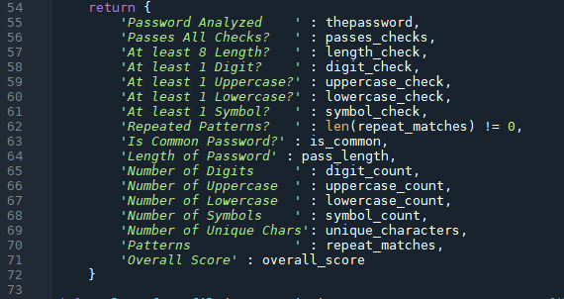
Notes:
Here are some screenshots of the Code we produced to analyze our dataset.
In the first blue box, we import the regex and csv libraries and assign file names to variables to use later.
These red boxes show our functions.
In the first function, we pass a password string into the check_password() function.
First, we find the password length, and add a check for a length greater than 8.
Next, using regex functions, we find the number of digits in the password, and add a check for at least 1 digit.
Similar code is then written for checking for uppercase letters, lowercase letters and symbols.
Next, we check for repeating characters like ss or abab.
We then import a file of the 10,000 most popular passwords and check if our password matches any of them.
Lastly, we count the number of unique characters in the password, and add a check for passing all previous checks.
Next, we calculate the overall score by summing the length, digit count and symbol count. Additionally, for every repeated character set detected, the score will decrease by 3, and if the password is common, the score will decrease by 10.
At the end of the function, we return all variables we calculated earlier with labels for readability.
In the next function, we pass the number of entries from the file we want to read into the analyze_from_file() function.
First, we open the file from the password data leak, and store our password entries into the passwords variable.
We then run the check_password() function on each password in the passwords variable, and store the overall score, length, commonality and unique character count and return them.
After the function, we define the number of entries we want to parse, and then feed that value into the analyze_from_file() function.
Next, we print each resulting row to the console and define our output file path.
Lastly, we write labels for each column of data, and write the data to a new row in the output.csv file.
A success message will print to console if the Code executed correctly.

Slide 11
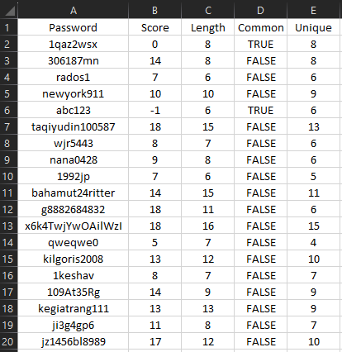
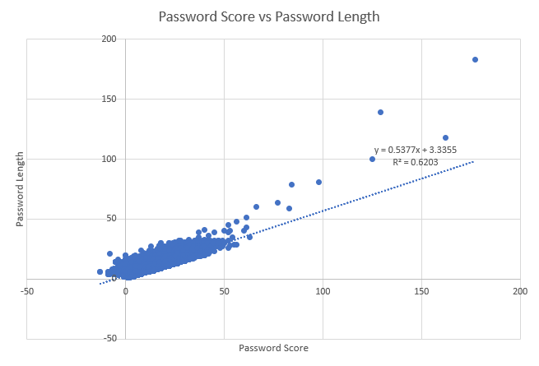
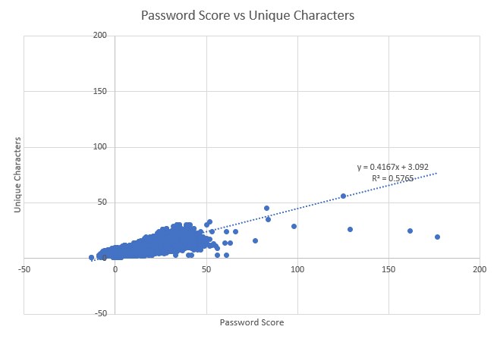
Results
Slope of Trendline: 0.5377
R² Value: 0.6203
Slope of Trendline: 0.4167
R² Value: 0.5765
Output.csv file that was saved when running our Code.
Average Score: 11.8290
Average Length: 9.6956
Average Unique Characters: 8.0213
Since the Second graph’s R Squared Value is less than the First’s, we can see that Unique Character count is a better fit to predict Score than Length.
Notes:
Now we’ll talk about our Data analysis results.
When we ran our code, the results were written to the output.csv file. A screenshot of the resulting raw csv file is shown on the slide.
At the bottom, we can see that the average score was 11.82, the average length was 9.69, and the average unique character count was 8.02.
On the right side of the slide are two scatter plots. One plots password score and length, and the other plots password score and unique character count.
Trendlines are drawn in each plot to show a line of best for the correlation between data. The Trendlines are labelled with their corresponding equation.
The first trendline has an R squared value of 0.6203, while the second trendline has an r squared value of 0.5765.
Since the Second graph’s R Squared Value is less than the First’s, we can see that, according to our scoring system, Unique Character count is a better fit to predict Score than Length is.

Slide 12
Conclusion
Cybersecurity is all about balancing convenience and security. Ideally, a password should be long and randomly generated
The number of unique characters in a password has more effect on the strength of a password than length does
Regardless of length or number of unique characters, passwords are much less secure when they include repeating characters or dictionary words
Both the length and the number of unique characters (complexity) are positively correlated with the strength of a password
Regardless of the strength, passwords should always be used in conjunction with multi factor authentication

